Slide 1

Web Development Foundations
03
Modern CSS Layouts and Responsive Design

Slide 2
Part 1: MCQ#1 and session assignments

Slide 3
MCQ #1
Graded Quiz covering contents from Sessions 01 & 02
Notes:
Part 1: Assessment & Review (40 Minutes)
MCQ #1 (20m): Conduct the first graded Knowledge Check (covering HTML Semantics and Accessibility).
Assignment Review (20m): Review common pitfalls from the "Hello World" enhancements.
Common Bug: Forgetting to link the CSS file in the <head>.
Common Bug: Labels not properly linked to Input IDs.

Slide 4
Session 2
Review common pitfalls
Assignment Review

Slide 5
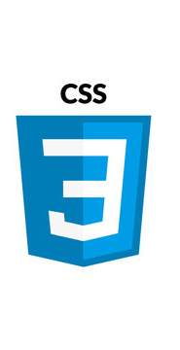
Part 2: Core of CSS
CSS: Cascading Style Sheets

Slide 6
Selectors
CSS Selector
Selects HTML elements
Applies styles to them
Can target elements by:
  Type
  Class
  ID
  Attributes
  State
  Position
Basic Selectors
  Element Selector
  Class Selector
  ID Selector
Combining Selectors
  Multiple Selectors
  Descendant Selector
Attribute Selectors
  Target elements by attribute
Pseudo-Classes
  Elements in a specific style
Notes:
Pseudo Classes:
a:hover {
color: red;
}
Other examples:
:focus
:active
:checked
:nth-child(2)
li:nth-child(2) {
color: orange;
}

Slide 7
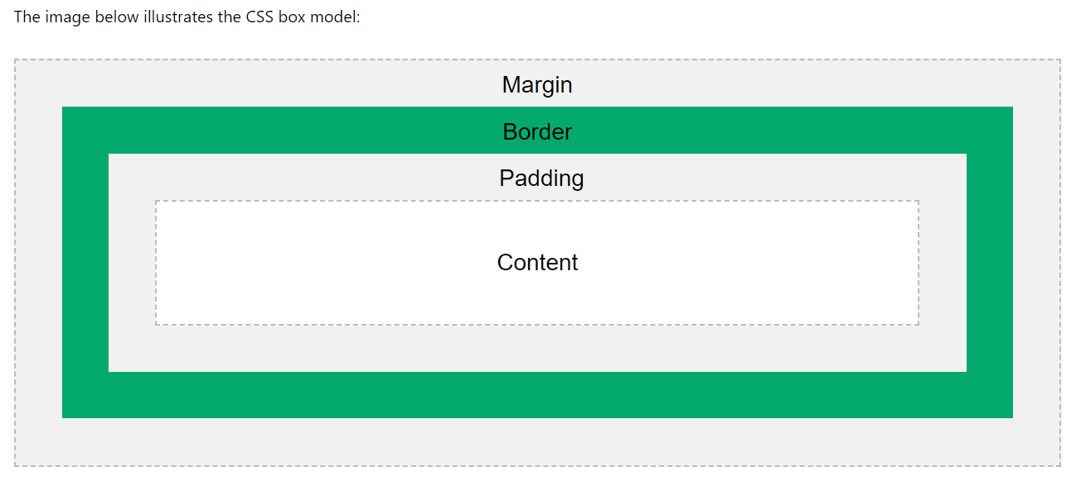
CSS Box Model
Content - The content of the box, where text and images appear
Padding - Clears an area around the content. The padding is transparent
Border - A border that goes around the padding and content
Margin - Clears an area outside the border. The margin is transparent
Source: w3schoools.com

Slide 8
Interactive Activity #1
Social Media Profile Card
Build a component on codepen.
Task: Create a square div (the profile picture) and give it a circular look using border-radius.
Challenge: Add a "Status Indicator" using a thick border.
Key Concept: Learn that border and padding can be used to create space around an image so it doesn't touch the edges of its "container."
Notes:
https://codepen.io/magnetik-works/pen/azZpKWd

Slide 9
Interactive Activity #2
Switch State
Build a component on codepen.
Task: Create a simple "Buy Now" button.
Challenge:
Change the background-color when the mouse hovers over it (:hover).
Change the border-style (e.g., from solid to dashed) when the button is clicked/held (:active).
Add a thick, bright outline when the button is tabbed into using a keyboard (:focus).
Key Concept: Accessibility and interactive feedback.
Notes:
https://codepen.io/magnetik-works/pen/QwEdZjV

Slide 10
10
Minute Break

Slide 11
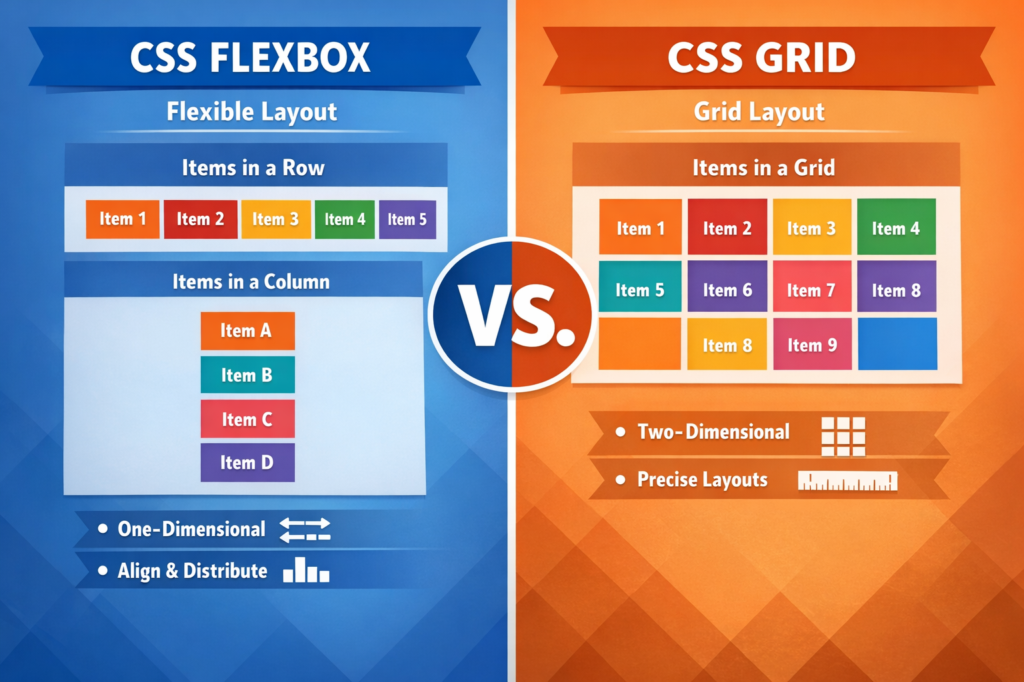
Part 3: Modern Layout Modules
Flexbox (The 1D Specialist)
  Perfect for rows or columns
  E.g; Navbars, button groups
  Key properties: justify-content, align-items, flex-direction.
Grid (The 2D Specialist)
  Perfect for full-page layouts.
  Key properties: grid-template-columns, gap, fr units.

Slide 12
Live Demo
Build a Hero Section
Notes:
Use Flexbox to center a "Call to Action" button inside the hero.
Use Grid to create a 3-column "Feature Gallery" below it that automatically wraps.
https://codepen.io/magnetik-works/pen/RNRKqgE

Slide 13

Interactive Activity
Flexbox Froggy
Go to https://flexboxfroggy.com/
Play first few levels to learn Flexbox through challenges

Slide 14
Responsive Design
Viewport Meta Tag
Without this tag, mobile browsers render pages at a desktop width (usually 980px) and then scale them down, making everything tiny and unreadable.
The Code: <meta name="viewport" content="width=device-width, initial-scale=1.0">

Slide 15
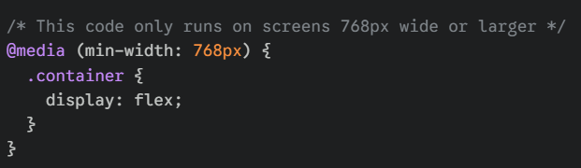
Responsive Design
Tip
Use Device Toolbar from DevTools to test different screen sizes
Media Queries
Media queries allow you to apply CSS only when specific conditions are met (like a minimum screen width).
Breakpoints: 768px is a common "breakpoint" because it’s where small screens (phones) transition to medium screens (tablets/small laptops).
Responsive Design Demo

Slide 16
Responsive Design
Mobile First
This is a professional industry standard. You design for the smallest screen first and add complexity as the screen gets wider.
Why Mobile First?
Performance: Leaner code for slower mobile networks.
Focus: Forces you to prioritize the most important content first.
Simplicity: It’s easier to turn a single-column layout into a multi-column grid than it is to "shrink" a complex desktop grid down to a phone.
The Workflow:
Base CSS: Styles for mobile (no media query needed).
Media Query (min-width: 768px): Styles for Tablets.
Media Query (min-width: 1024px): Styles for Desktop.

Slide 17
Assignment #1 UI Components
Goal
To build the core structural and visual components of a modern website using Semantic HTML5 and Responsive CSS.
These components are the "puzzle pieces" that will form the foundation of your final Project.
Requirements
https://github.com/magnetikworks/web-development-foundations/blob/main/assignments/assignment-01-ui-library.md

Slide 18
Additional Reading
Read up on Advanced selectors and use them in your portfolio for styling
  https://css-tricks.com/a-complete-guide-to-css-media-queries/
  https://developer.mozilla.org/en-US/docs/Learn_web_development/Core/CSS_layout/Responsive_Design

Slide 19
Summary
1. The Box Model is Everything
Every element is a box. Use border-box to keep your math simple and your layouts predictable.
2. Selectors are Your Precision Tools
Don't over-use IDs. Use Classes for styling and Pseudo-classes (:hover) for interactivity.
3. Choose the Right Layout Engine
Flexbox: For lining things up in a single direction (Navbars).
Grid: For defining a structure of rows and columns (Page layouts).
4. Design for Mobile First
Start with the small screen. Use Media Queries to "add" complexity as the screen gets wider.

